Slide 1
1. For a single bus organization , write the complete control sequence for the following instructions.
a) Add the immediate number NUM to the register R1.
PC out, MAR in, Read,select 4,Add,Zin
Zout, Pcin, Yin, MDRinE ,WMFC.
MDR out,IRin
IR Num out, Yin.
Select Y, R1out,Add,Zin
Zout, Rin,End

Slide 2
ADD (NUM),R1
PC out, MAR in, Read,select 4,Add,Zin
Zout, Pcin, Yin, MDRinE ,WMFC.
MDR out,IRin
IR Num out, MARin,Read
MDRinE ,WMFC, MDRout
Yin,R1out, Select Y, Add,Zin
Zout, Rin,End

Slide 3
LOAD 10(R2),R1
MAR ← R2 + 10 (Calculate the effective address by adding the content of Register R2 and the offset 10)
MDR ← Memory[MAR] (Read the content of memory at the calculated address and store it in the Memory DATA Register MDR)
R1 ← MDR (Copy the data from MBR to Register R1)
PC out, MAR in, Read,select 4,Add,Zin
Zout, Pcin, Yin,WMFC.
MDR out,IRin
R2out,Yin,IR10 out
Select Y,ADD,Zin
Zout,MARin,READ,
WMFC,MDRout,R1in,End

Slide 4
STORE R1,10(R2)
PC out, MAR in, Read,select 4,Add,Zin
Zout, Pcin, Yin,WMFC.
MDR out,IRin
R2out,Yin,IR10 out
Select Y,ADD,Zin
Zout,MARin,
R1out,Yin
MDRin, MDRout,write
WMFC,End

Slide 5
DIV R1,(R2) using single bus
PC out, MAR in, Read,select 4,Add,Zin
Zout, Pcin, Yi,WMFC.
MDR out,IRin
R2out,MAR in,READ
R1out, Yin, WMFC
MDR out, select y, DIV, Zin
Zout, MDR in, write
WMFC, END

Slide 6
STORE R6,(R8)
PC out, MAR in, Read,select 4,Add,Zin
Zout, Pcin, Yin,WMFC.
MDR out,IRin
R8 out,MAR in
R6out,MDR in,write
MDR outE,WMFC,END

Slide 7
STORE R6,X(R8)
PC out, MAR in, Read,select 4,Add,Zin
Zout, Pcin, Yin,WMFC.
MDR out,IRin
R8 out, Yin
IR X Out,select y, add,Zin
Zout,R8 in
R8 out, MAR in
R6 out, MDRin,write
MDRoutE,WMFC, END

Slide 8
ADD [R1],[R2]
PC out, MAR in, Read,select 4,Add,Zin
Zout, Pcin, Yin,WMFC.
MDR out,IRin
R1 out, MAR in, READ
MDR In E,WMFC
MDR out, Yin
R2 out, MAR in, READ
MDR In E,WMFC
MDR out, select y, Add, Zin
Zout, MDRin, write
MDRout E,WMFC

Slide 9
Transfer contents of register R5 to R1
Set output enable signal of R5 to high. This places contents of R5 on the bus. Next set input enable signal of R1 to high. This loads data from processor bus to register R1.
Move (R6), R2
Fetch a word from memory and move it to register R2, when the memory address is stored in register R6
4. R6out, MARin, Read
5. MDRinE, WMFC
6. MDRout, R2in
MOVE R2,(R1).
1) | R1_{out}, MAR_{in} | ;desired address is loaded into MAR.
2) | R2_{out}, MDR_{in}, Write | ;data to be written are loaded into MDR & Write command is issued.
3) | MDR_{outE}, WMFC | ;load data into memory-location pointed by R1 from MDR.

Slide 10
ADD R1,NUM
PC out, MAR in, Read,select 4,Add,Zin
Zout, Pcin, Yin,WMFC.
MDR out,Irin
IR NUMout,MAR in,READ
WMFC,MDRout,Yin
selectY,R1out,ADD,Zin
Zout,MDRin,WRITE
WMFC,END

Slide 11
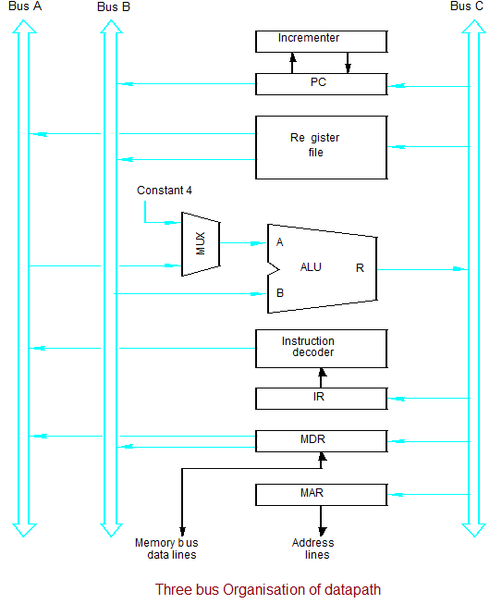
Multiple-Bus Organization

Slide 12
Multiple-Bus Organization
General purpose registers are combined into a single block called register file.
There are 2 output ,Allowing the contents of two different registers to be accessed simultaneously and have their contents placed on buses A and B.
the 3rd port allow the data on bus C to be loaded into a third register during the same clock cycle.
Buses A and B are used to transfer the source operands to the A and B inputs of the ALU, where an arithmetic or logic operation may be performed.
The result is transferred to the destination over bus C.
If needed, the ALU may simply pass one of its two input operands unmodified to bus C. We will call the ALU control signals for such an operation R=A or R=B.

Slide 13
Incrementer unit.
which is used to increment the PC by 4. Using the Incrementer eliminates the need to add 4 to the PC using the main ALU,
It can be used to increment other addresses, such as the memory addresses in LoadMultiple and StoreMultiple instructions.

Slide 14
Multiple-Bus Organization
Add R4, R5, R6
Step
Action
1
PC
out
,
R=B,
MAR
in
,
Read,
IncPC
2
WMF
C
3
MDR
outB
,
R=B,
IR
in
4
R4
outA
,
R5
outB
,
SelectA,
Add,
R6
in
,
End
Figure 7.9. Control sequence for the instruction. Add R4,R5,R6,
for the three-bus organization in Figure 7.8.

Slide 15
Step 1:The contents of PC are passed
through the ALU using R=B control signal & loaded into MAR to start a memory read operation
At the same time PC is incrementer by 4
Step 2:The processor waits for MFC
Step 3: Loads the data ,received into MDR ,then transfers them to IR.
Step 4: The execution phase of the instruction requires only one control step to complete.

Slide 16
Write the control sequence For DIV R1,[R2] in a 3 bus structure
PC out, R=B, MAR in, READ, Inc PC
WMFC
MDR outB, R=B, IRin
R2out B, MARin , R=B, read
Wmfc
MDR out B, R1 out A,select A, div, MDR in
MDR OUT B,WMFC,END

Slide 17
SUB R3,(R4)
PC out, R=B, MAR in, READ, Inc PC
WMFC
MDR outB, R=B, IRin
R4out B,MARin, R=B,read
Wmfc
MDRout B,R3out A,select A,sub,MDRin
MDR out B, WMFC,END

